Slide 1
REVIEW

Slide 2
I. ENOUGH, TOO, SO THAT, SUCH THAT
1/ ENOUGH
The boy is strong enough to lift the vase.
S + be + adj + enough + (for sb) + to V…
The boy ran quickly enough to catch the bus.
S + V + adv + enough + (for sb) + to V…
The hotel has enough rooms for everyone to stay.
S + V + enough + noun (for sb) + to V…

Slide 3
I. ENOUGH, TOO, SO THAT, SUCH THAT
2/ TOO…TO…
The food is too hot for us to eat.
S + be + too + adj + (for sb) + to V…
He drove too quickly for anyone to catch him up.
S + V + too + adv + (for sb) + to V…

Slide 4
I. ENOUGH, TOO, SO THAT, SUCH THAT
3/ SO…THAT…
The food was so hot that we couldn’t eat it.
S + be + so + adj + that + S + V…
He drove so quickly that no one could catch him up.
S + V + so + adv + that + S + V…
4/ SUCH…THAT…
She is such a beautiful girl that everyone likes her.
It was such bad weather that we had to cancel the race.
S + V + such + (a/an) + adj + noun + that + S + V

Slide 5
I. ENOUGH, TOO, SO THAT, SUCH THAT
1. It was such an expensive house that we couldn’t buy it.
→ The house was so _______________________________
→ The house was too______________________________
→ The house wasn’t _______________________________
2. He did so well in the exam that he ranked 1st in his class. → He did ________________________________________
expensive that we couldn’t buy it.
expensive for us to buy .
cheap enough for us to buy .
well enough in the exam to rank 1st in his class.

Slide 6
3. This room is too dark for me to study. → This room is so ________________________________
→ It is _________________________________________
4. These rooms are too small for us to hold the meeting
→ These rooms aren’t _____________________________
→ These rooms are so _____________________________
→ They are ______________________________________
dark that I can’t study.
such a dark room that I can’t study.
large enough for us to hold the meeting.
small that we can’t hold the meeting.
such small rooms that we can’t hold the meeting.

Slide 7
II. PRESENT PERFECT
S + have/has + V-ed/P.P…+ (for/since…)
They have waited for the bus for half an hour.
FOR + a period of time (khoảng thời gian)
SINCE + a point in time in the past (thời điểm cụ thể trong QK)
* SINCE + S + V(past)
He has worked for this company since he graduated.

Slide 8
II. PRESENT PERFECT
Present perfect ⬄ Past simple
S + have/has + V_{3/ed} for /since…
→ S + started/began ( to V/ V_{ing} )…ago/in/when..
Mary has played chess for 10 years.
→Mary started playing chess 10 years ago.
They began to live here when they were 12.
→ They have lived here since they were 12.

Slide 9
II. PRESENT PERFECT
Present perfect ⬄ Past simple
S + last V_{2/ed} ago/in/when…
The last time + S + V_{2/ed} … was + time
→ S + haven’t /hasn’t + V_{3/ed} for /since…
Mary hasn’t played chess for 10 years.
→Mary last played chess 10 years ago.
→ The last time Mary played chess was 10 years ago.
They last came here when they were 12.
→ They haven’t come here since they were 12.

Slide 10
1. I haven’t seen Nhi for 2 years.
-> __________________________________________________
2. I started writing blog 2 months ago.
->___________________________________________________
3. I haven’t gone to school since last June because of covid-19.
-> ________________________________________________
4. She has learned English since last year.
-> ________________________________________________
5. The last time John cooked was in 2019.
-> ________________________________________________
6. It has rained for 2 days.
->_________________________________________________
I last saw Nhi 2 years ago.
I have written blog for 2 months.
The last time I went to school was last June because of covid-19.
She started learning English last year.
John hasn’t cooked since 2019.
It started raining 2 days ago.

Slide 11
A VISIT FROM A PEN PAL
UNIT 1:
LESSON 1: GETTING STARTED
LISTEN AND READ
Lan
Maryam

Slide 12
A foreign friend is coming to stay with you for a week. Where would you take him/her to?

Slide 13
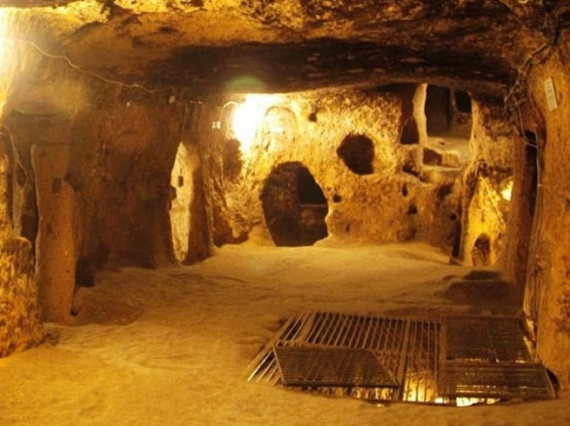
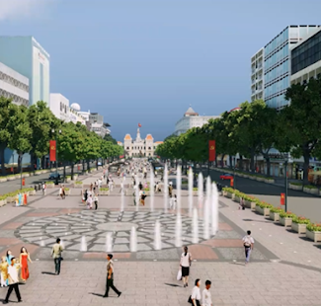
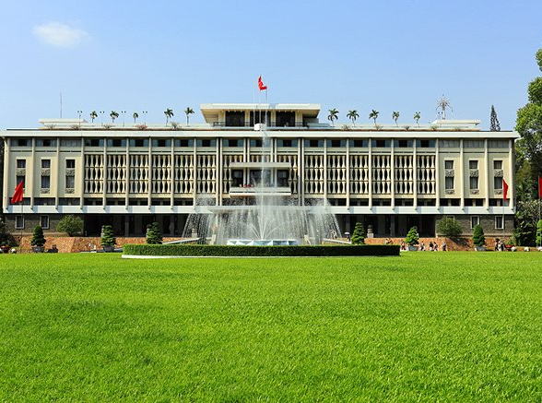
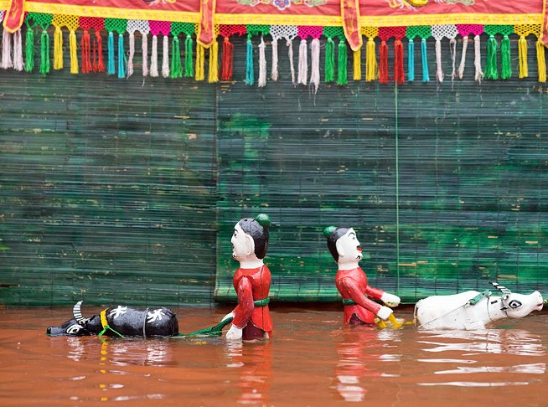
Ben Thanh
market
3
4
Nguyen Hue
walking street
1
Cu Chi Tunnels
2
Reunification Palace
Independence Palace
Golden Dragon
Water Puppet Theatre
5

Slide 14
Lan’s Malaysian pen pal, Razali Maryam, was staying with Lan last week. Maryam is from Kuala Lumpur. Maryam and Lan have been pen pals for over two years and they correspond at least once every two weeks, but this was their first meeting.
On Maryam's first day in Ha Noi, Lan took her to Hoan Kiem Lake. Like Kuala Lumpur, Ha Noi is a busy modern city. Maryam was really impressed by the beauty of the city and by the friendliness of its people.
Over the next few days, the girls visited Ho Chi Minh's Mausoleum, the History Museum and the Temple of Literature, as well as many beautiful parks and lakes in Ha Noi. On Friday, Maryam wanted to visit the mosque on Hang Luoc Street. Lan used to walk past the mosque on her way to primary school. However, this was Lan’s first visit. She enjoyed the peaceful atmosphere while Maryam was praying.
“I wish you had a longer vacation,” Lan said to Maryam at the end of the week.
“Yes, I wish I had more time to get to know your beautiful country better. Lan, would you like to come and visit me next summer?” Maryam asked.
“That would be great! However, it seems very difficult for me to have a trip abroad. It all depends on my parents. Anyway, we’ll keep in touch.”

Slide 15
VOCABULARY
1. correspond /ˌkɒrəˈspɒnd/ (v):
2. modern /ˈmɒdn/ >< ancient /ˈeɪnʃənt/ (a):
3. impress /ɪmˈpres/ (v):
+ be impressed by sth:
4. friendliness /ˈfrendlinəs/ (n):
5. mausoleum /ˌmɔːsəˈliːəm/ (n)
6. mosque /mɒsk/ (n)
7. peaceful atmosphere /ˈpiːsfl/ /ˈætməsfɪə(r)/:
8. pray /preɪ/(v):
9. abroad /əˈbrɔːd/ (a)
10. depend on /dɪˈpend/ = rely on /rɪˈlaɪ/ :
11. keep in touch with:
trao đổi thư từ
hiện đại >< cổ xưa
gây ấn tượng
bị ấn tượng bởi
sự thân thiện
lăng mộ
nhà thờ Hồi giáo
bầu không khí thanh bình
cầu nguyện
(ở, đi) nước ngoài
tùy thuộc vào, dựa vào
giữ liên lạc

Slide 16
Choose the correct option to complete the sentence (page 7)
1. Lan and Maryam usually write to one another every….
A. two years.
B. month.
C. two weeks.
D. day.

Slide 17
Choose the correct option to complete the sentence (page 7)
2. Maryam was impressed because
A. Ha Noi was big and modern
B. Ha Noi people were friendly
C. Ha Noi was different from Kuala Lumpur
D. Ha Noi and Kuala Lumpur were the same.

Slide 18
Choose the correct option to complete the sentence (page 7)
3. The girl went to see…
A. famous places in Ha Noi.
B. areas for recreation.
C. a place for worship.
D. all above.

Slide 19
Choose the correct option to complete the sentence (page 7)
4. Maryam wanted to…
Visit Ha Noi the next summer.
B. invite Lan to Kuala Lumpur.
C. stay in Ha Noi
D. visit Ho Chi Minh city

Slide 20
Answer the questions
1. Where is Maryam from?
2. How long have Lan and Maryam been pen pal?
3. What places did Lan take her to?
4. What was Maryam impressed by during the visit?
Maryam is from Malaysia.
They have been pen pal for over 2 years.
Lan took Maryam to Hoan Kiem Lake, Ho Chi Minh's Mausoleum, the History Museum, the Temple of Literature, as well as many beautiful parks and lakes in Ha Noi. They also visited the mosque on Hang Luoc Street.
Maryam was really impressed by the beauty of the city and by the friendliness of its people.

Slide 21
SPEAKING TASK
If you have a chance to go on a one-day trip with foreign friend, where would you go?
Name of the place
Activities during the day

